Slide 1
Homework
Decide your topic.
Week 9- 确定主题?
Week 10- 搜集资料
Week 11-制作PPT初稿
Week 12- PPT定稿和排练
Week 13-展示
2. Preview Unit 6 and answer the questions about 5Ws.

Slide 2
Lecture 10
News from you
News from me
Unit 6
News bias

Slide 3
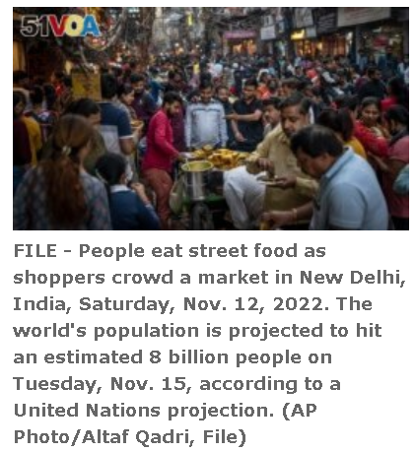
UN: India to Have World’s Largest Population later This Year
By Dan Friedell
19 April 2023

Slide 4
The United Nations estimates India will pass China to have the world's largest population sometime later this year. This comes from the U.N. Population Fund's State of the World Population report.
Both countries have over 1.4 billion people. But India will have about 3 million more people than China sometime around the middle of 2023. The last time India counted its population through a census was 2011. It is not possible to say exactly when India will overtake China. Together, the countries combine for about one third of the world's population.

Slide 5
China has been the world's largest country since at least 1950. That is the first year the U.N. issued population numbers.
India's population is four times larger than it was when the country gained independence 76 years ago. Recent guesses said India would not surpass China in population until later this decade, but China's birth rate has gone down. While India's birth rate is also going down, China's population is getting older. China's population decreased last year for the first time in about 60 years.
Notes:
India has 254 million people between the ages of 15 and 24. That is the most in the world. India's fertility rate – the average number of children each woman gives birth to – has been decreasing since 1960. But the country's medical system is improving. More babies are surviving their first year of life. The infant mortality rate has gone down over the past 30 years.
The country could become an economic power. But experts are concerned that there are not enough jobs for young Indians. If the population grows and jobs do not, many people could fall into poverty. Right now, the Center for Monitoring the Indian Economy (CMIE) says only 40 percent of working-age Indians have jobs.
Mahesh Vyas is the center's director. He called the growing population a "demographic dividend." But he said the country has failed to create enough jobs to see gains from its young workers. He noted that the number of jobs available in India over the last six years has remained at about 405 million.
India has changed from an impoverished nation in 1947 to Asia's third largest economy, valued at $3 trillion. The country exports computer software and vaccines. Millions of people have moved from poverty to the middle class as the number of educated people has grown.
Poonam Muttreja is head of the Population Foundation of India. She said the country must plan now for its young people. The country needs to invest in jobs and education.
"This large population will need a huge investment in skills for them to take advantage of the opportunities that will come up in the economy," she said. She added that India needs to pay attention to women and girls as the population grows so they are not "pushed into early marriages and pregnancies, which limit their aspirations."
The U.N. asked over 1,000 Indians questions about their concerns related to population growth. Sixty-three percent said they were worried about economic issues, followed by the environment and health and human rights.
In China, a foreign ministry spokesperson responded to the U.N.'s report and noted that the most important thing is not a country's population, but its ability to get the most out of the people it has.
"The population is important," said Wang Wenbin. "So is talent," he said, noting "quality" is more important than "quantity."
I'm Dan Friedell.

Slide 6
India has 254 million people between the ages of 15 and 24. That is the most in the world. India's fertility rate – the average number of children each woman gives birth to – has been decreasing since 1960. But the country's medical system is improving. More babies are surviving their first year of life. The infant mortality rate has gone down over the past 30 years.
The country could become an economic power. But experts are concerned that there are not enough jobs for young Indians
Notes:
Mahesh Vyas is the center's director. He called the growing population a "demographic dividend." But he said the country has failed to create enough jobs to see gains from its young workers. He noted that the number of jobs available in India over the last six years has remained at about 405 million.
India has changed from an impoverished nation in 1947 to Asia's third largest economy, valued at $3 trillion. The country exports computer software and vaccines. Millions of people have moved from poverty to the middle class as the number of educated people has grown.
Poonam Muttreja is head of the Population Foundation of India. She said the country must plan now for its young people. The country needs to invest in jobs and education.
"This large population will need a huge investment in skills for them to take advantage of the opportunities that will come up in the economy," she said. She added that India needs to pay attention to women and girls as the population grows so they are not "pushed into early marriages and pregnancies, which limit their aspirations."
The U.N. asked over 1,000 Indians questions about their concerns related to population growth. Sixty-three percent said they were worried about economic issues, followed by the environment and health and human rights.
In China, a foreign ministry spokesperson responded to the U.N.'s report and noted that the most important thing is not a country's population, but its ability to get the most out of the people it has.
"The population is important," said Wang Wenbin. "So is talent," he said, noting "quality" is more important than "quantity."
I'm Dan Friedell.

Slide 7
If the population grows and jobs do not, many people could fall into poverty. Right now, the Center for Monitoring the Indian Economy (CMIE) says only 40 percent of working-age Indians have jobs.
Mahesh Vyas is the center's director. He called the growing population a "demographic dividend." But he said the country has failed to create enough jobs to see gains from its young workers. He noted that the number of jobs available in India over the last six years has remained at about 405 million.
Notes:
India has changed from an impoverished nation in 1947 to Asia's third largest economy, valued at $3 trillion. The country exports computer software and vaccines. Millions of people have moved from poverty to the middle class as the number of educated people has grown.
Poonam Muttreja is head of the Population Foundation of India. She said the country must plan now for its young people. The country needs to invest in jobs and education.
"This large population will need a huge investment in skills for them to take advantage of the opportunities that will come up in the economy," she said. She added that India needs to pay attention to women and girls as the population grows so they are not "pushed into early marriages and pregnancies, which limit their aspirations."
The U.N. asked over 1,000 Indians questions about their concerns related to population growth. Sixty-three percent said they were worried about economic issues, followed by the environment and health and human rights.
In China, a foreign ministry spokesperson responded to the U.N.'s report and noted that the most important thing is not a country's population, but its ability to get the most out of the people it has.
"The population is important," said Wang Wenbin. "So is talent," he said, noting "quality" is more important than "quantity."
I'm Dan Friedell.

Slide 8
India has changed from an impoverished nation in 1947 to Asia's third largest economy, valued at $3 trillion. The country exports computer software and vaccines. Millions of people have moved from poverty to the middle class as the number of educated people has grown.
Poonam Muttreja is head of the Population Foundation of India. She said the country must plan now for its young people. The country needs to invest in jobs and education.
Notes:
"This large population will need a huge investment in skills for them to take advantage of the opportunities that will come up in the economy," she said. She added that India needs to pay attention to women and girls as the population grows so they are not "pushed into early marriages and pregnancies, which limit their aspirations."
The U.N. asked over 1,000 Indians questions about their concerns related to population growth. Sixty-three percent said they were worried about economic issues, followed by the environment and health and human rights.
In China, a foreign ministry spokesperson responded to the U.N.'s report and noted that the most important thing is not a country's population, but its ability to get the most out of the people it has.
"The population is important," said Wang Wenbin. "So is talent," he said, noting "quality" is more important than "quantity."
I'm Dan Friedell.

Slide 9
"This large population will need a huge investment in skills for them to take advantage of the opportunities that will come up in the economy," she said. She added that India needs to pay attention to women and girls as the population grows so they are not "pushed into early marriages and pregnancies, which limit their aspirations."
The U.N. asked over 1,000 Indians questions about their concerns related to population growth. Sixty-three percent said they were worried about economic issues, followed by the environment and health and human rights.
Notes:
In China, a foreign ministry spokesperson responded to the U.N.'s report and noted that the most important thing is not a country's population, but its ability to get the most out of the people it has.
"The population is important," said Wang Wenbin. "So is talent," he said, noting "quality" is more important than "quantity."
I'm Dan Friedell.

Slide 10
In China, a foreign ministry spokesperson responded to the U.N.'s report and noted that the most important thing is not a country's population, but its ability to get the most out of the people it has.
"The population is important," said Wang Wenbin. "So is talent," he said, noting "quality" is more important than "quantity."
I'm Dan Friedell.

Slide 11

Unit 6 Science and Technology

Slide 12

Warm-up
  What do you know about iPad?

Slide 13



Slide 14


Tablet wars:
Google looks to take on
Apple iPad

Slide 15


Proper Noun
Google Chrome OS
an upcoming Linux-based, open-source operating system designed by Google to work exclusively with web applications

Slide 16
Headline： Tablet wars:
Google looks to take on Apple iPad
Who/ what/ why: Para1-2
5 Ws: Inverted Pyramid Form
  Where/ when: Para 3-4
  What (the details of the design)：Para 5-11
How (How could Google beat Apple): Para 12-20

Slide 17
Text analysis
Para1—2: Google unveiled concept designs for its own version of a tablet, a counterpart of Apple’s new iPad.
  who/ what/ why

Slide 18
Text analysis
Para 3—4: Some background information about the release of the mock tablet design.
  where/ when

Slide 19
Para 5-11: Design features of Google’s tablet
  operating system in respect of optimization for a tablet/ target market /current development
  screen
  user interface
  virtual keyboard
  hardware

Slide 20
Taking on Apple: Who wins?
Para 12—20：Advantages of Google to take on the iPad.
  the most apps or the best apps

Slide 21
Headline： Tablet wars:
Google looks to take on Apple iPad
Who/ what/ why: Para1-2 Google unveiled concept designs for its own version of a tablet, a counterpart of Apple’s new iPad.
5 Ws: Inverted Pyramid Form
  Where/ when: Para 3-4 Some background information about the release of the mock tablet design.
  What：Para 5-11 Design features of Google’s tablet. OS；screen; user interface; virtual keyboard; hardware
How: Para 12-20 Advantages of Google to take on the iPad. the best apps.

Slide 22



Discussion: What is the news reporter’s attitude toward Google? Positive, Negative or Neutral?

Slide 23
Attitudes in News Reports
Page 11 Journalistic objectivity:
not making up facts; showing political position; not trying to avoid bias
Discussion:
What is the news reporter’s attitude toward same-sex marriage? Toward Apple and Google?

Slide 24
I. Balance — Fairness
Watch 3 videos
Fairness in news report
Fairness in news report (2)
Fairness and balance in news report

Slide 25
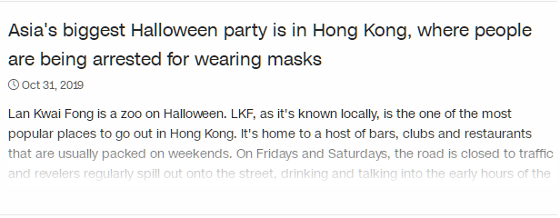

Notes:
https://edition.cnn.com/videos/world/2019/10/31/hong-kong-halloween-protests-ripley-lkl-vpx.cnn/video/playlists/around-the-world/

Slide 26

Protests instead of parties for Halloween in Hong Kong
More protests erupt on Halloween night as Hong Kong demonstrations enter the 22nd week. CNN's Will Ripley reports.
Source: CNN
Notes:
https://edition.cnn.com/videos/world/2019/10/31/hong-kong-halloween-protests-ripley-lkl-vpx.cnn/video/playlists/around-the-world/

Slide 27
Bias in the News
Through Selection or Omission
Through placement
By headline?
By photo caption and angles
Through the use of names and titles
Through statistics and crowd accounts
By source controls
By word choice and tone

Slide 28
Does a newspaper choose to include an article about a certain event, person, idea or not?
What does this tell us about the editors in the newspaper?
Through Selection or Omission

Slide 29
2. Through placement
Where does the article appear in the newspaper? Front page? Above/below the fold? In the back of the paper?
What does this tell us bout the editors of the newspaper?

Slide 30

3. By headline?

Slide 31
4. By photo caption and angles
What impression do you get from the photo?
What impression do you get from the cutline/caption?
What does this tell us about the photographer/editors?

Slide 32

5. Through the use of names and titles

Slide 33

5. Through the use of names and titles

Slide 34
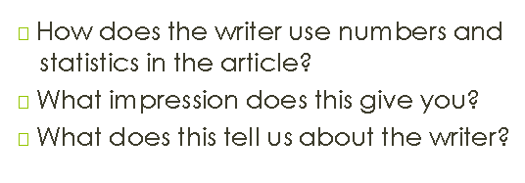
6. Through statistics and crowd accounts

Slide 35
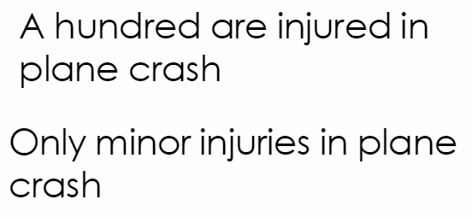
6. Through statistics and crowd accounts

Slide 36
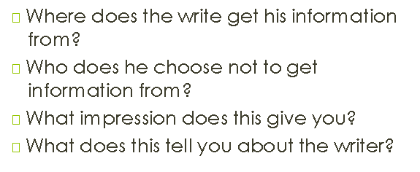
7. By source controls

Slide 37
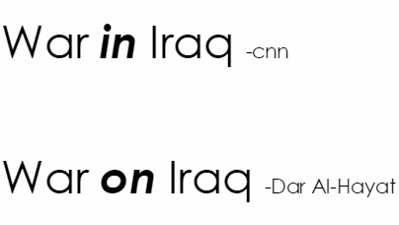
8. By word choice and tone

Slide 38
Read for attitude
Finish all the exercises on the following worksheet
named “Reading Newspaper for attitude”.
Get ready to explain your choices.

Slide 39
Homework
完成 第六单元阅读作业.
搜集小组新闻展示的材料。
时间安排：
9周确认主题—10周收集材料—11周制作PPT初稿—12周PPT定稿及排练—13周展示

